Slide 1
COCOMO Model for cost estimation
Constructive Cost Model is an algorithmic software cost estimating model developed by Barry Boehm.
The COCOMO model make use of some basic regression formula having parameters that are derived from old project data and characteristics and from current project characteristics.
Class of Software Projects :
Organic class: In this class, size of development team is small and team members are experienced in developing similar kind of projects. The application program is also well understood by developers.
Semi Detached class: In this class, development team is mixture of experienced and inexperienced staff. The project may contain some unfamiliar aspects that need to be developed. Which is the case in our project. Experience of resources in our team ranges from 2-4 years in the field of Backend and frontend programming, UX from Java, Angular, .Net etc.
Embedded class: In this class, project is tightly coupled with complex hardware, software and operational constraints.

Slide 2
Types of COCOMO
Basic COCOMO: Development effort is estimated as a function of program size. It uses only Lines of code.
Effort applied = a^{i}(KLOC) b^{i} [man-months]
Development Time = c^{i} (Effort Applied) d^{i} [months]
People required = Effort Applied / Development Time [count]
Intermediate COCOMO : here we add set of "cost driver attributes" apart from basic model to estimate the effort and duration of the project, such as assessments of personnel and hardware.
List of attributes are:
● Product attributes,
● Hardware attributes,
● Personnel attributes
● Project attributes.
These attributes are also rated on a 6-point scale ranging from "very low" to "extra high" in importance.
Effort applied = a^{i}(KLOC) b^{i} [man-months] X Effort Adjustment Factor

Slide 3
Detailed COCOMO: Cost drivers impact on each step of the development is considered. Here we again extend all features of the intermediate version and apply assessment on each step (analysis, design, etc.) of the software engineering process using of the cost driver's impact.
In complete COCOMO model large systems are divided into several sub-systems. Each sub-system have widely different characteristics. The detailed COCOMO model considers these differences in characteristics of the subsystems to calculate the effort and development time as the sum of the estimates of sub-systems. The major benefit of this system is that it reduces the margin of error in final estimate.
Historical data used for estimates
Historical data can be collected from similar projects delivered earlier. As the project is
only for simulation purpose and no actual hardware device is made out of it; the estimates may be displayed as follows:
Effort = 5 Person per month (6 hrs per week per person, 120 hrs per month)
Schedule = 80-90 days (2.5 – 3 months)
Cost = No cost

Slide 4
Steps to calculate estimations using COCOMO 2
1st- Calculate Unadjusted Function Points (UFP)
external input which receives information from outside the application boundary,
external output which presents information of the information system,
external enquiries which is special kind of an external output. An external inquiry presents information of the information system based on a uniquely identifying search criterion.
internal logical files contains permanent data that is relevant to the user. The information system references and maintains the data.
external interface files also contains permanent data that is relevant to the user. The information system references the data, but the data is maintained by another information system

Slide 5
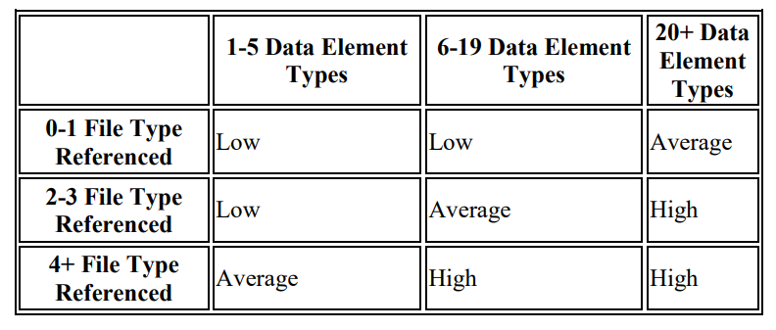
The Unjustified Function Points (UFP) are calculated as sum of function points for each component
((n * I)+(n * O)+(n * Q)+(n * F)+(n * E)).
20
Function type | Low | Average | High | No. | Total
Internal Logical File | 7 | 10 | 15 | 1 | 7
External Interface File | 5 | 7 | 10 | 0 | 0
External Input | 3 | 4 | 6 | 3 | 9
External Output | 4 | 5 | 7 | 1 | 4
External Inquiry | 3 | 4 | 6 | 0 | 0

Slide 6
2nd - Calculate SLOC
JAVA and Javascript are chosen as our programming language. Language Factor (LOC per function point is around 300 average for both.)
So Lines of Code = 20*300 = 6000
Convert SLOC into KLOC by dividing it by 1000 = 6000/1000 = 6
3rd - Calculate Effort Adjustment Factors using Cost Drivers
To calculate the Complexity adjustment value, several factors have to be considered, which are divided into these 4 classes :
Product, Personal, Computer and Project attributes

Slide 7
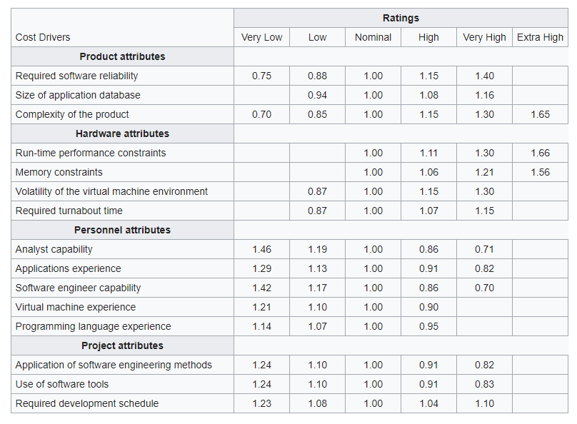
EAF =
Multiplication of the choosen factor values =
0.74

Slide 8
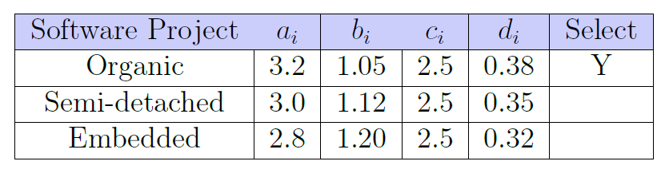
4th – Calculating Persons per month and Development time using COCOMO
Effort applied = a^{i}(KLOC) ^{bi} * EAF [man-months]
Development Time = c^{i} (Effort Applied) ^{di} [months]
People required = Effort Applied / Development Time [count]
Effort Applied = 3.0 * (6) ^{1.12} * 0.74 = 16.5 [man-months]
Development Time = 2.5 * (16.5) ^{0.35} = 6.7 months
People Required = 16.5/6.7 = 2.5 people
As we are a team of 5 people, So
Development Time = 16.5/5 = 3.3 months
Y

